Slide 1
Research question and headline answer
Do team winning streaks increase AFL match attendance?
A descriptive analysis of AFL match-level attendance, 2000–2024
≈ 2.7%
≈ 930
Not causal
higher attendance per extra game in the maximum pre-match winning streak
extra spectators at the average crowd of 34,440
a robust conditional association, not proof of cause and effect
Bottom line: longer pre-match winning streaks are consistently associated with higher AFL crowds, but unobserved demand factors remain the key limitation.
ECC3479 | Data and Evidence in Economics | AFL attendance
1

Slide 2
Why this question matters
Attendance is not just a sporting outcome, it is also an economic outcome.
Clubs
Venues
League
Crowds affect match-day revenue, sponsorship value and fan engagement.
Attendance shapes staffing, utilisation, transport planning and food/beverage demand.
Fixture planners and broadcasters care about what makes games attractive.
Winning streaks may signal momentum, team quality and expectation. The empirical question is whether that pattern remains visible after accounting for basic match, season and venue differences.
This is a demand-pattern question, not a causal design
ECC3479 | Data and Evidence in Economics | AFL attendance
2

Slide 3
Data: AFL match-level records, 2000–2024
Concrete sample, variables and restrictions used for the final analysis.
4,643
AFL Tables
Positive
Pre-match
matches in the final analysis sample
match-level data collected via reproducible pipeline
attendance required for log outcome
streaks use only prior results
Outcome
Main variable
Controls
log(attendance) Used because crowds are right-skewed and the coefficient has an approximate percentage interpretation.
max_pre_streak The larger of the two teams’ winning streaks entering the match.
Finals match, match margin, season fixed effects and venue fixed effects.
Scope limitation: match-level data cannot observe individual fan choices, ticket prices, weather, broadcast timing or membership status.
ECC3479 | Data and Evidence in Economics | AFL attendance
3

Slide 4
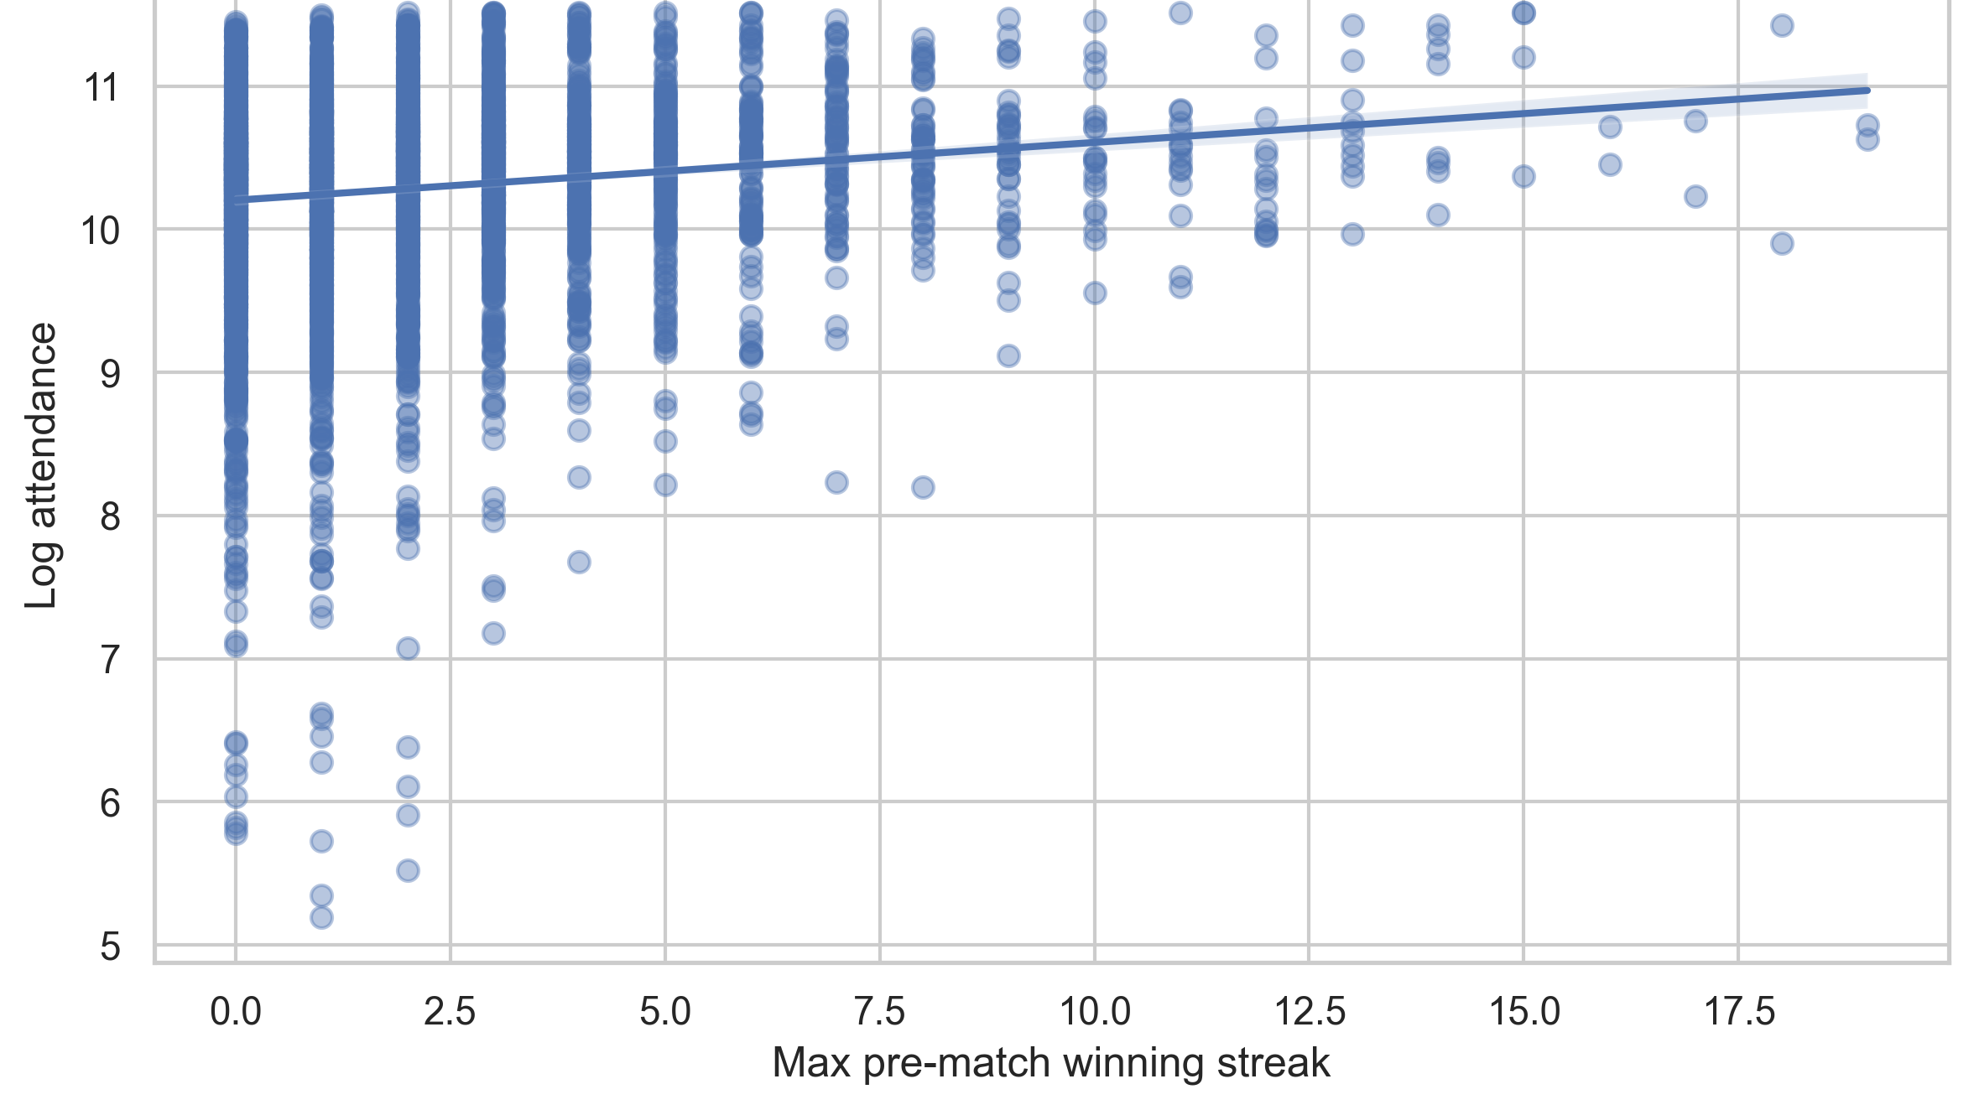
Raw pattern: longer streaks tend to draw larger crowds
This motivates the regression, but does not control for match, season or venue differences.
What it shows
The fitted line slopes upward: higher streaks tend to sit with higher log attendance.
What it does not show
The raw plot does not separate streaks from finals, venue capacity, season or match context.
Motivation for regression
ECC3479 | Data and Evidence in Economics | AFL attendance
5

Slide 5
Empirical strategy: estimate a descriptive association
The model compares matches with different streak lengths, conditional on observed match context.
log(attendance) = max_pre_streak + finals + margin + season FE + venue FE + error
Why these controls?
Coefficient meaning
Interpretive assumption
Finals, margin, season and venue capture major observable sources of crowd demand.
One extra streak game is read as an approximate percentage difference in attendance.
For a descriptive claim, the controls make comparisons more like-for-like, but still not causal.
Remaining threat: unobserved demand factors such as team popularity, opponent quality, weather, time slot, ticket prices and broadcast scheduling may still move both streaks and attendance.
ECC3479 | Data and Evidence in Economics | AFL attendance
4

Slide 6
Main result: preferred estimate is about 2.7%
The coefficient falls after controls, but remains positive and precise.
Model | Coef. | SE | Controls
Raw | 0.040 | 0.004 | None
Match + season | 0.028 | 0.003 | Finals, margin, season
Preferred | 0.027 | 0.002 | + venue fixed effects
≈ 2.7%
higher attendance per extra game in the maximum pre-match winning streak
≈ 930
extra spectators at the average crowd
How to read the progression
Plain English
The raw association is partly explained by match and season context. Venue fixed effects make only a small further change.
After controlling for finals, margin, season and venue, longer streaks are still associated with higher crowds.
Direction: positive. Magnitude: 2.7%. Units: approximate percent higher attendance per additional streak game. Economic scale: about 930 spectators.
ECC3479 | Data and Evidence in Economics | AFL attendance
6

Slide 7
Robustness: the result survives distinct stress tests
Each check probes a different way the descriptive result could have been fragile.
Check family | What it probes | Outcome
Controls | Is the raw result just match/season/venue context? | Positive: 0.040 → 0.027
Samples | Is it driven by finals or COVID seasons? | Positive: 0.028 regular season; 0.024 no COVID
Functional form | Does log vs level or nonlinearity change the story? | Positive; however quadratic suggests diminishing returns
Inference | Does clustering by venue remove precision? | Positive: 0.027, SE 0.003
What would worry me
What actually happens
A sign reversal, near-zero coefficient in key subsamples, or a loss of precision under clustered inference.
The sign and precision hold, but the exact magnitude is smaller after controls and no-COVID restriction.
ECC3479 | Data and Evidence in Economics | AFL attendance
7

Slide 8
Conclusion: strong pattern, cautious interpretation
The evidence supports a robust descriptive association, not a causal effect.
What we can conclude
What we cannot conclude
What would improve it
Winning streaks are consistently associated with higher AFL attendance in this match-level dataset.
The analysis cannot prove that winning streaks themselves cause crowds to rise.
Richer demand data or a quasi-experimental design that isolates unexpected variation in team form.
To improve the estimate: collecting data on currently unobserved demand factors such as supporter base size, opponent quality, fixture attractiveness, weather, ticket prices and broadcast slot.
Bottom line: robust conditional association, but the causal mechanism remains open
ECC3479 | Data and Evidence in Economics | AFL attendance
8

